Slide 1
Computer Architecture in the 20th Century
Chuck Thacker
Microsoft Research Silicon Valley
January 2013

Slide 2
Outline
Computer progress, 1945 – 2000
Exponential drivers for computing
Architectural ideas, 1945 – 2000
Putting it all together – a circa-2000 CPU
What’s changing in the 21st century?

Slide 3
Computer progress 1945 - 2000
Excellent summary: http://www.computerhistory.org/timeline.
Trends:
Underlying technologies evolved rapidly, and were quickly adopted for computers:
Vacuum tubes -> Transistors -> Bipolar ICs -> CMOS ICs
Delay lines -> CRT -> Magnetic core -> DRAM
Cards, paper tape -> magnetic drum, tape -> magnetic disc
Teletype, line printer, CRT display, laser printer, bitmapped display
Computer software improved to keep pace:
Assembler -> FORTRAN, Algol, COBOL -> Pascal, C -> Java, C# -> JavaScript, Ruby, Python (all sequential languages).
Computer architectures grew increasingly sophisticated:
Original Von Neumann architecture survived, but changed.
1-bit (serial) -> 8, 16, 32, 64 bit parallel machines
Vector supercomputers -> Gaming GPUs -> Vector supercomputers
CISC vs RISC, architectural improvements for performance, scale

Slide 4
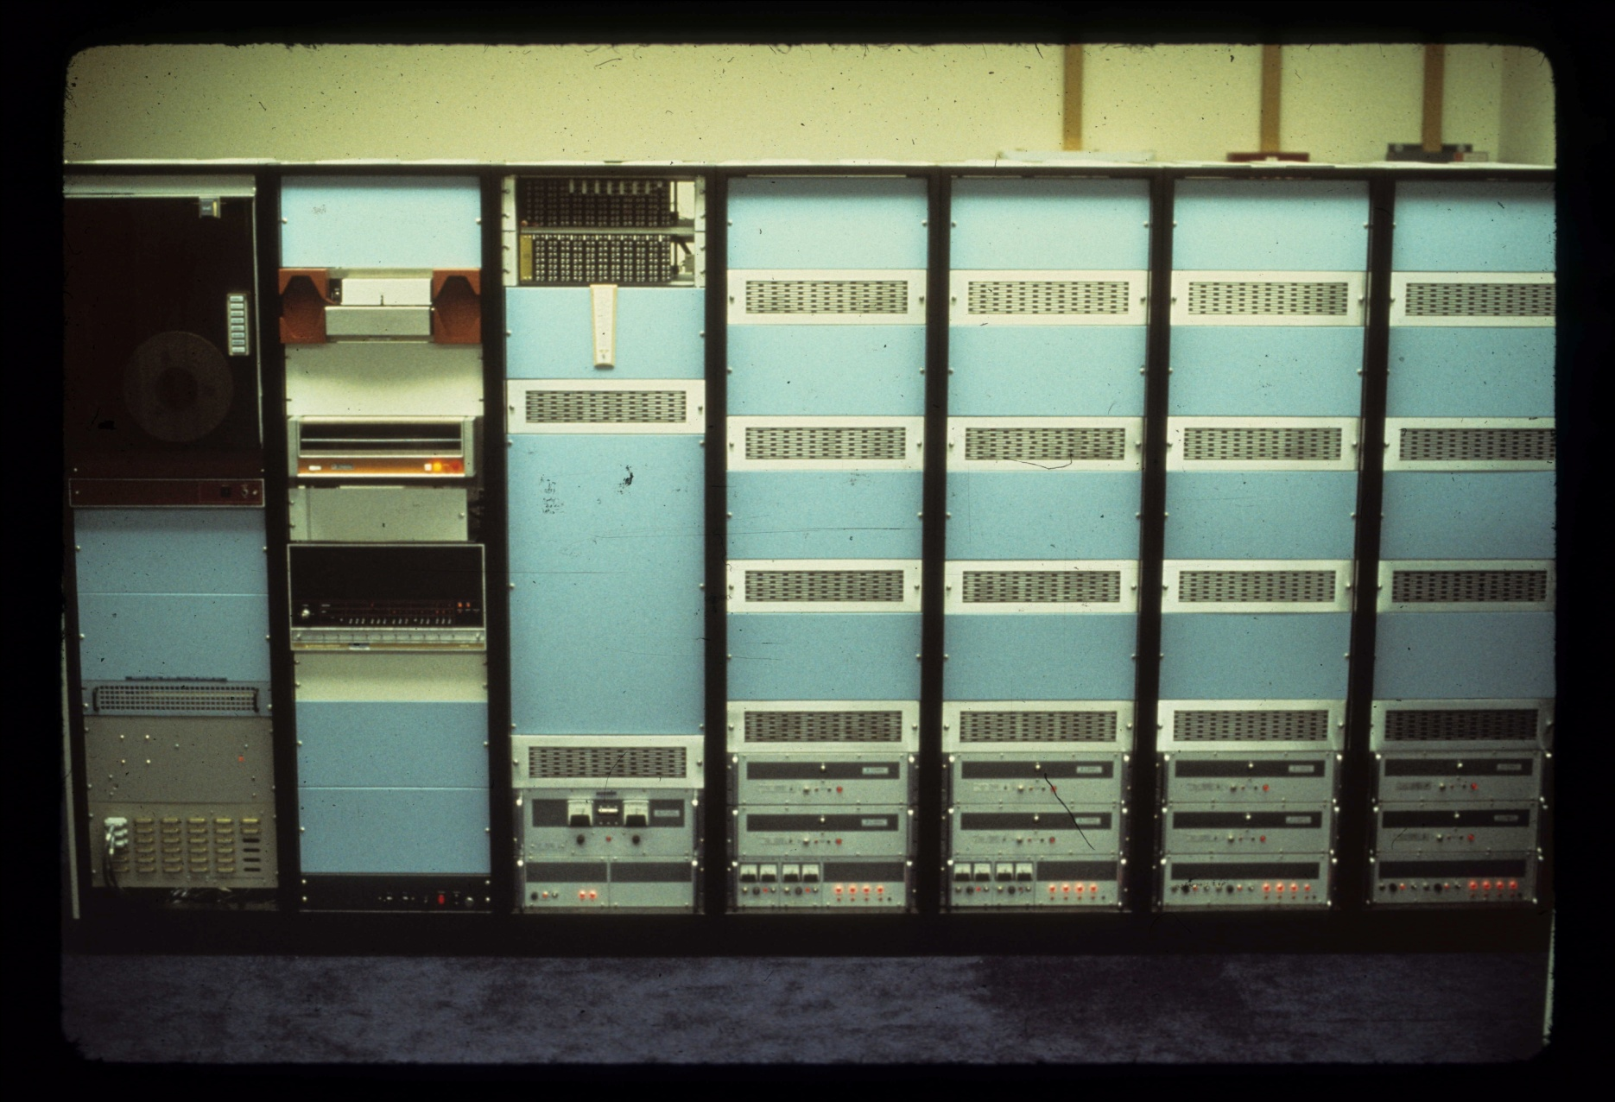
An Impersonal Computer from 1972 MAXC: The end of an era
Notes:
An equivalent system in 1950 would fill a building.
Today, MAXC fits on a single chip.

Slide 5
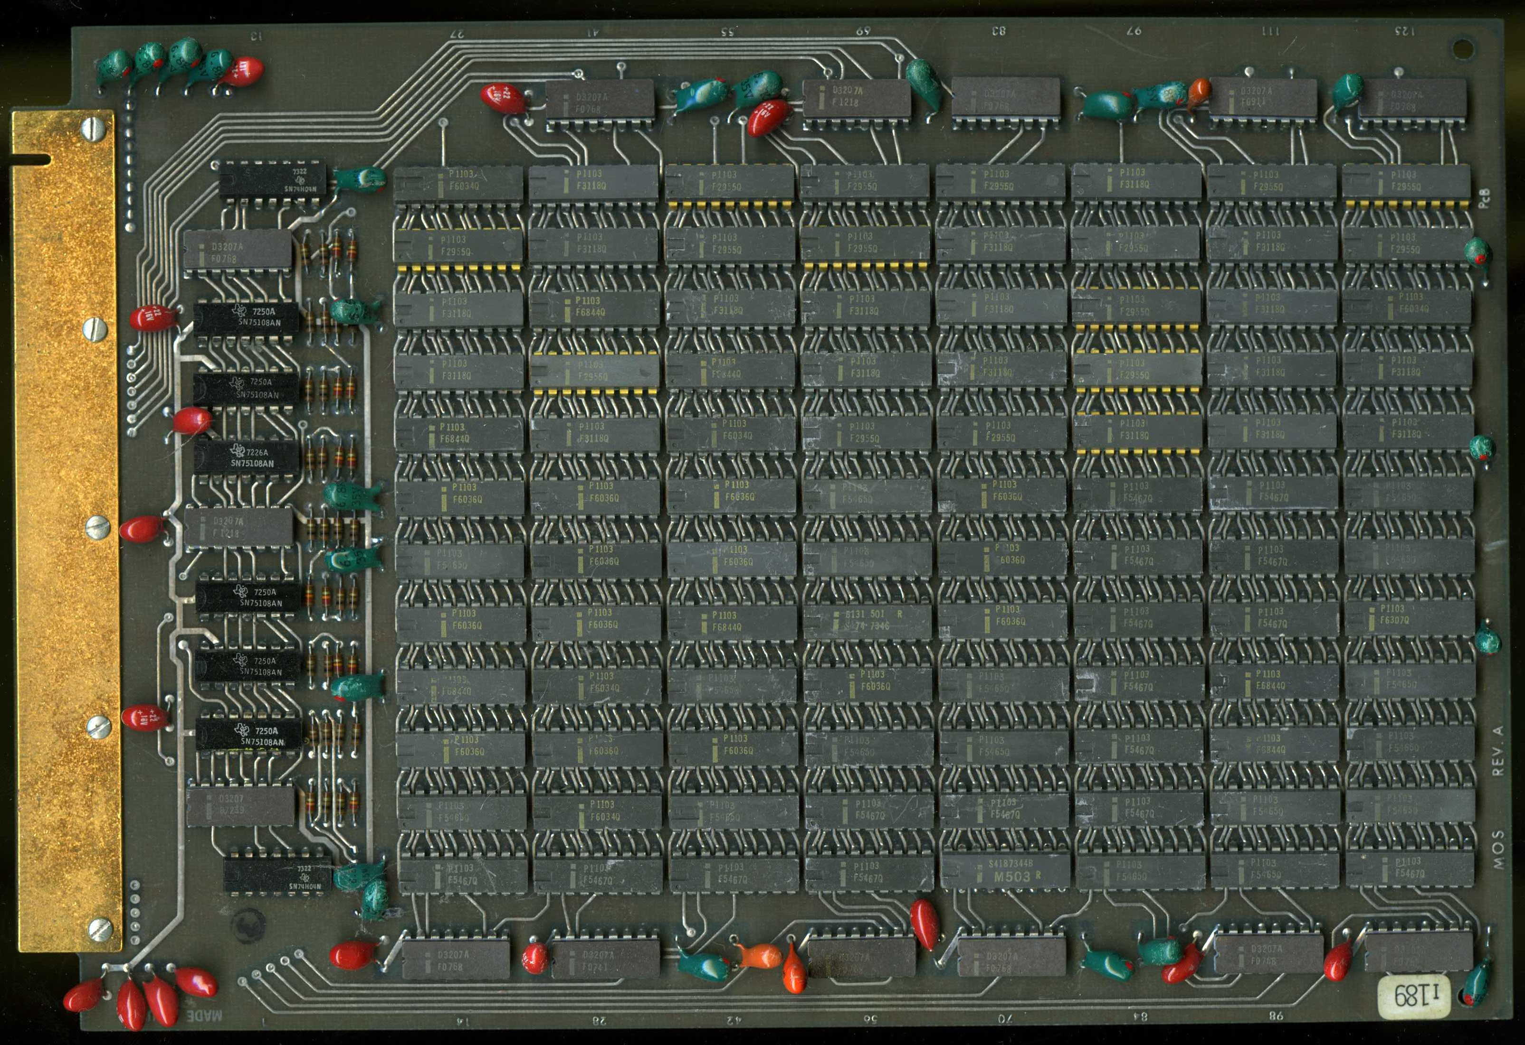
96,000 bits in 1972

Slide 6
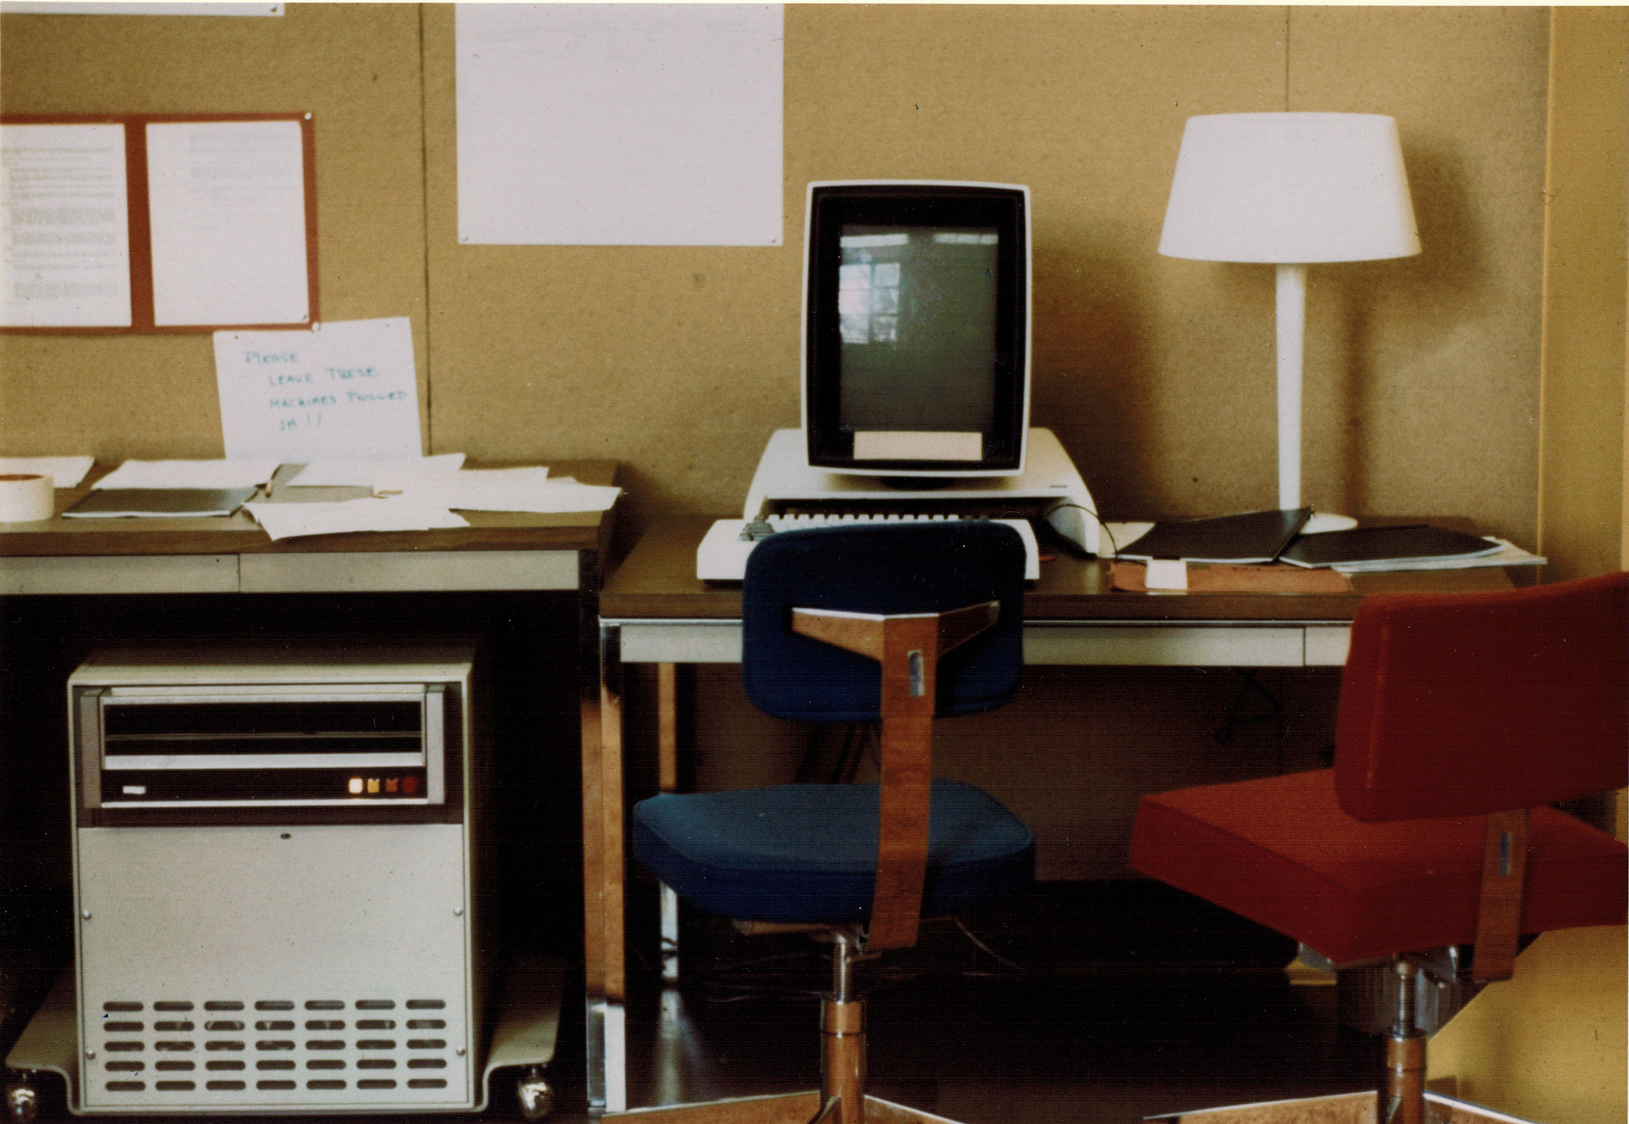
The Alto Personal Computer - 1973

Slide 7
How much progress?
Item | Alto, 1972 | My home PC, 2012 | Factor
Cost | $ 15,000 ($105K today) | $850 | 125
CPU clock rate | 6 MHz | 2.8 GHz (x4) | 1900
Memory size | 128 KB | 6 GB | 48000
Memory access | 850 ns | 50 ns | 17
Display pixels | 606 x 808 x 1 | 1920 x 1200 x 32 | 150
Network | 3 Mb Ethernet | 1 Gb Ethernet | 300
Disk capacity | 2.5 MB | 700 GB | 280000

Slide 8
Exponential drivers for computing
Rotating magnetic storage
Today, we can store every bit of information we receive during a lifetime on a few disks.
Glass fibers
No two points on earth are more than 70ms apart
On the wired phone network, not the Internet.
Bandwidth is no longer scarce.
Semiconductors and Moore’s Law (1965)
Often misunderstood

Slide 9
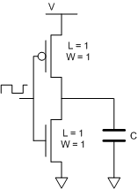
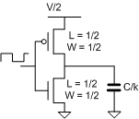
Some physics – Dennard scaling (1975)
P = CV² f
Relates power, capacitive load, operating voltage, and frequency in CMOS circuits.
If we scale the dimensions and V down by k:
P’ = (C’ V’²f’) = (C/k)(V/k)² f’ = CV²f/k³
Capacitance is C/k because although the area goes down by k², the dielectric is 1/k as thick.
k is the “feature size”: 90nm -> 45 nm is k = 2.
Our new circuit is 1/k² the area and1/k³ the power (at the same frequency) of the original version.
Our new chip should also be cheaper, since $ = Area.
This works well for feature sizes > 100nm or so.
It doesn’t work today, since we can’t continue to scale V, and we can’t get rid of the heat.
If f’ = kf, the power per unit area is unchanged. Making a bigger chip means making a hotter chip.
Semiconductor makers have used scaling in very different ways for memories and CPUs.

Slide 10
Scaling for Memories and CPUs
Memory manufacturers used scaling to improve density.
Lower voltage, somewhat higher frequency and power, but lots more bits.
CPU manufacturers took another path: Higher clock rates, more complex designs to make sequential programs run faster.
Result: CPUs got very hot (the power wall), and memories got bigger, but not much faster (the memory wall).
Future trend: Rather than a single fast CPU, we will see many simpler CPUs on each chip, or a mix of complex and simple CPUs as well as other logic (graphics and I/O).
Moore’s law is not at an end.
These choices have profound effects on architecture and software:
We can no longer rely on scaling for improved performance.
We must use architectural improvement instead.
We must do better at parallel software
But that’s for another talk. Let’s look now at how architectural improvements were used in the 20th century.

Slide 11
What is computer architecture?
Fred Brooks (“The Mythical Man-Month): “…there must be few architects, their product must endure longer than that of an implementer, and the architect sits at the focus of forces which he must ultimately resolve in the user’s interest”.
Hennessy & Patterson (“Computer Architecture: A Quantitative Approach”):
“This task has many aspects, including instruction set design, functional organization, logic design, and implementation. The implementation may encompass integrated circuit design, packaging, power, and cooling. Optimizing the design requires familiarity with a very wide range of technologies, from compilers and operating systems to logic design and packaging”.
Brooks made a clear distinction between architecture and implementation. Today, it’s more blurred.
Notes:
All people in computing should have “The Mythical Man-month” as required reading.

Slide 12
Architectural ideas from the 20th century
The Von Neumann architecture
Microprogramming
Pipelining
Virtual memory
Vector machines
Caches
RISC machines
Error detection/correction
Multi-threading
Speculative execution

Slide 13
The Von Neumann Architecture
Parallel, not serial as most machines at that time were
Three subsections:
Memory
4096 40-bit words. RCA Selectron tubes (didn’t work)
Arithmetic.
Parallel binary arithmetic
I/O system.
Magnetic wire, display (“viewing tubes”)
Simple instruction set:
Indexed addressing
Single accumulator
Conditional and unconditional jumps
Divide, but no multiply. Puzzling.

Slide 14
The Von Neumann architecture (2)
This architecture is still in use in essentially all modern computers
Alan Turing had proposed an architecture, which was built as the “Pilot ACE”. Used ultrasonic delay line memory, and was very difficult to program. Although it had a commercial successor, H. Huskey’s drum-based Bendix G15, the architecture was largely ignored by others.
Von Neumann pursued the simplest possible organization consistent with performance.
He worried about numeric precision and algorithm performance.

Slide 15
Microprogramming
Maurice Wilkes (1948) realized that the most complex part of the computer was the control.
Proposed a simpler machine, whose programs were the instructions of a more complex target machine. Today, we call this emulation.
The instructions for the micro machine were in fast read-only storage.
Others elaborated on the idea, using read/write storage
Idea used by IBM, DEC, Xerox, Intel, and many others.

Slide 16
Pipelining
Basic idea:
Rather than doing all the work in one (long) clock cycle, break it up into N(4 shown) clock cycles.
If the logic delays of each stage are similar, the clock can be N times as fast.
Typical early CPU pipeline:
Instruction Fetch, Instruction Decode/Register read, Execute, Memory access, Register write
Pipeline in a modern CPU is 20+ stages.
Asynchronous pipelines, in which each stage takes only as long as needed and there is no clock, are an interesting possibility, but are (almost) never used.

Slide 17
Pipelining (2)
An instruction takes six clocks to complete, but the CPU delivers one result per clock, if…
Later instructions don’t depend on earlier results.
If they do, we have a hazard (several types).
Tricks: stall (bubbles), bypass (adds complexity)

Slide 18
Virtual Memory
Introduced in the Manchester Atlas (’60s) by T. Kilburn.
16 KW core memory (small, fast).
1 MW magnetic drum (large, slow).
Basic idea: Make the core memory appear to be as large as the drum.
Divide core memory into 32 512-word pages.
Use an associative memory (TLB) to map virtual (drum) addresses to real (core) addresses.
Also used a “learning program” to decide which pages to transfer to and from drum.
Today, we would call this an operating system.
Used in most computers today.
Except supercomputers and embedded systems.

Slide 19
Problems VM still solves today
The size of real memory is no longer a problem.
Protection
This will be a problem as long as we program in languages with pointers.
Relocation
Segments are simpler.
Fragmentation
Compacting garbage collectors?
VM was invented in a time of scarcity. Is it still a good idea?

Slide 20
Vector machines
Used in CDC6x00, Cray, … “supercomputers”.
Basic idea:
One instruction computes a result for a multi-element vector (SIMD).
Hides memory latency if carefully applied (Supers didn’t have caches, but did have interleaved memory banks).
Problem: Stride is important.
Survives today in:
Intel SSE, GPUs, DSPs, “Stream processors”

Slide 21
Caches and cache coherence
Caches exploit two properties of programs to hide latency:
Temporal coherence: If a program accesses location X, it’s likely to need X again soon, so don’t discard X after use.
Spatial coherence: If a program access location X, it’s likely to need X+n soon, so we should fetch x..x+K from memory as a block (a “cache line”).
Access time = Ht_{cache} + (1 – H)t_{memory}. H is the “hit rate”.
This is the Atlas idea again, with lines instead of pages.
There are many variations, and a few rules of thumb.
Until the ’70 cache coherence wasn’t an issue, but multicomputers and faster CPUs changed this.
With uniprocessors, we only needed to worry about I/O coherence.
With early multiprocessors, bus-based snooping protocols were adequate and simple.
With the larger-scale multiprocessors of the ‘80s, more complex protocols were needed.
Busses no longer worked. Point-to-point links were needed.
Protocol complexity skyrocketed, requiring formal methods to ensure correctness. Larger design teams were needed.
Notes:
Investigation of systems using caches was one of the first examples of the “simulator driven” or quantitative approach to architecture research.
The early ‘80s were also the time at which a small group of researchers could build and use their own experimental computers. The cost of chip fabrication precluded this.

Slide 22
RISC: Reduced Instruction Set Computers
In the ‘60s and ‘70s, instruction sets and the complexity of implementations grew significantly:
Von Neumann’s original architecture had ~25 instructions.
DEC’s VAX, Intel x86 had >200.
“Feature creep” is an easy trap to fall into, if technology is improving rapidly. And it was.
Several researchers at IBM, Berkeley, and Stanford, realized that compilers weren’t making use of the complex instructions and addressing modes, so they simply eliminated them.
Possibly there was a hidden agenda as well.
The RISC – CISC “wars” raged for several years, until the CISC proponents noticed that microprogramming could be used to provide backward compatibility at low cost.
Today, even x86 machines are RISCs.

Slide 23
Error Detection and Correction
This isn’t an architectural idea, but an implementation technique. But important.
Early machines made a lot of errors.
Von Neumann proposed building two side-by-side computers that would compare answers and stop is they were different. This is used in a slightly different form (TMR) in some high reliability machines today (e.g. for spacecraft)
Coding techniques developed in the ‘50s and ‘60s made error checking and correction less expensive.
As electronics became more reliable, designers worried less
The original Cray I didn’t have parity.
As transistors and disk bits got smaller, the problem reappeared:
If the difference between a “1” and a “0” is 1000 electrons, you have a problem.
We also began using technologies that wear out with use (Flash, PCM).
Today, all disks have error detection, memories have ECC.
Except for consumer products and desktop PCs

Slide 24
Multithreading
Another technique to hide memory latency/ increase instruction-level parallelism (ILP).
Several variants:
Launch several instructions from the same thread each cycle. Works if the instructions use different execution units or if there are multiple functional units.
Launch one instruction per cycle, switch threads when the processor would stall.
Combinations of the two.
Each processor must hold the state of all its threads (another way to use up transistors).
Lots of LPR papers have been written about how to schedule the threads.

Slide 25
Speculative execution
Yet another try at squeezing the last bit of ILP out of programs.
Basic idea:
If the outcome of a calculation is not known (yet) guess, or try both paths.
Began with branch prediction. Worked fairly well.
Extended to value prediction
And to transactions (more in next lecture).
Problems:
Can’t commit a result until the outcome is known. Requires more state (more transistors, more energy).
Speculation that is discarded wastes energy.

Slide 26
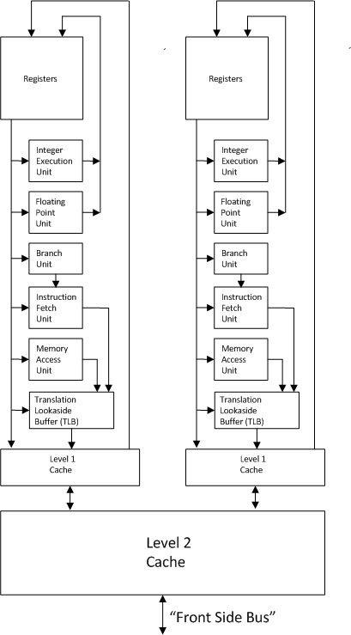
Putting it all together: A late 20th century dual-core CPU

Slide 27
An early 21st century PC

Slide 28
What’s Changing in the 21st century?
Dennard scaling stops, but Moore’s “law” doesn’t.
CPUs aren’t faster, but there are more of them on each chip.
Other things get swept onto the same “System on a Chip (SOC)”:
Northbridge, Southbridge, Memory Controller, GPU, network
Functional specialization makes the CPU less important.
Large data centers do the heavy lifting.
Computer architecture and computer networking research areas merge.
These are the topics for the next lecture.

Slide 29
Thank you!

